Slide 1
Analysis of Emotion Recognition using Speech
Sangeet Sagar (15uec053)
Under Guidance of
Dr. Joyeeta Singha
Dr. Navneet Upadhyay
Department of Electronics and Communication Engineering
The LNM Institute of Information Technology, Jaipur
May 2018

Slide 2
Outline
Objective
Previous Work
Proposed System
Results and Outcomes
Conclusion and Future Work

Slide 3
Purpose of the Project
Study different emotion specific features from speech signal
Implement different feature extraction for Speech signal
Suggest best suitable features for emotion classification
Extensive comparison of accuracy between pre-existing techniques and the proposed method.

Slide 4
Previous Work
S-transform is a more dynamic feature extraction technique over MFFC.
Sad emotion gave the best fit model where as for angry, it was the least.
S-transform gave a recognition accuracy of 85.4 % where as MFCC gave 83% over 5 emotions namely Angry, Disgust, Fear, Happy, Sad, Surprise (SAVEE database).
The robustness of the proposed feature is evidenced from the goodness of fit graph in modeling the chosen emotional states.

Slide 5
Previous Work: Results (SAVEE Database)
Feature dimension used for testing | MFCC | S-Transform
Total testing features | 9600 | 96000
Features classified as Angry | 986 | 8454
Features classified as Disgust | 1490 | 14329
Features classified as Fear | 1427 | 12623
Features classified as Happy | 869 | 14588
Features classified as Sad | 2693 | 28071
Features classified as Surprise | 2135 | 17935
Average accuracy % | 83.0417% | 85.4104%

Slide 6
Proposed Method: Using Speech
Database : Emo-DB
Feature Extraction: Spectrogram
Characterization
Classification
Notes:
LP VQC (Linear prediction vector quantizer coefficients)
pH VQC (Hurst parameter vector quantizer coefficients)
Radial Basis Function Neural Network (RBFNN)

Slide 7

Database
Name of Database | Berlin Database of Emotional Speech (Emo-DB)
Number of Speaker | 10 (5 Female and 5 Male)
Number of Emotions | 4(Angry, Happy, Neutral, Sad)
Number of samples for each emotion | Angry-127, Happy-71, Neutral-79, Sad-62
Sampling Frequency | 16 kHz
Notes:
LP VQC (Linear prediction vector quantizer coefficients)
pH VQC (Hurst parameter vector quantizer coefficients)
Radial Basis Function Neural Network (RBFNN)

Slide 8
Feature Extraction: Spectrogram
Acoustic speech characteristics vary in frequency, time and intensity.
One of the most common ways of observing these variations is via the speech spectrogram.
A spectrogram is the visual representation of a signal strength over time at different frequencies.
It is represented by a two-dimensional graph in which time is shown along the horizontal axis, frequency along the vertical axis.
Notes:
LP VQC (Linear prediction vector quantizer coefficients)
pH VQC (Hurst parameter vector quantizer coefficients)
Radial Basis Function Neural Network (RBFNN)

Slide 9
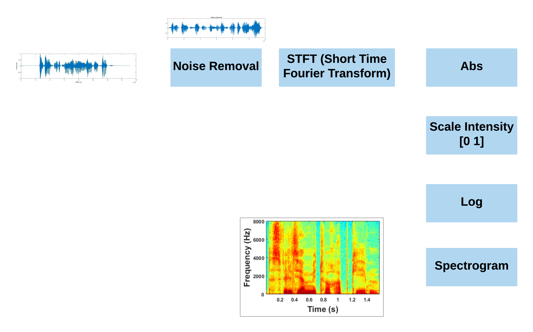
Feature Extraction: Spectrogram
Notes:
The amplitude of the frequency components at a particular time is indicated by the intensity or color of that point in the graph. Low amplitudes are represented by dark blue colors and stronger (or louder) amplitudes are represented by brighter colors up through red.

Slide 10
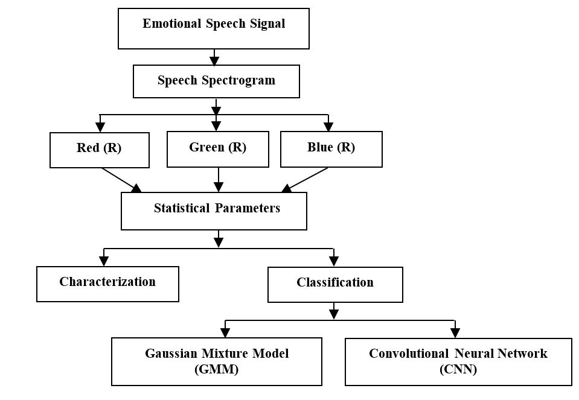
Proposed Methodology
Notes:
LP VQC (Linear prediction vector quantizer coefficients)
pH VQC (Hurst parameter vector quantizer coefficients)
Radial Basis Function Neural Network (RBFNN)

Slide 11
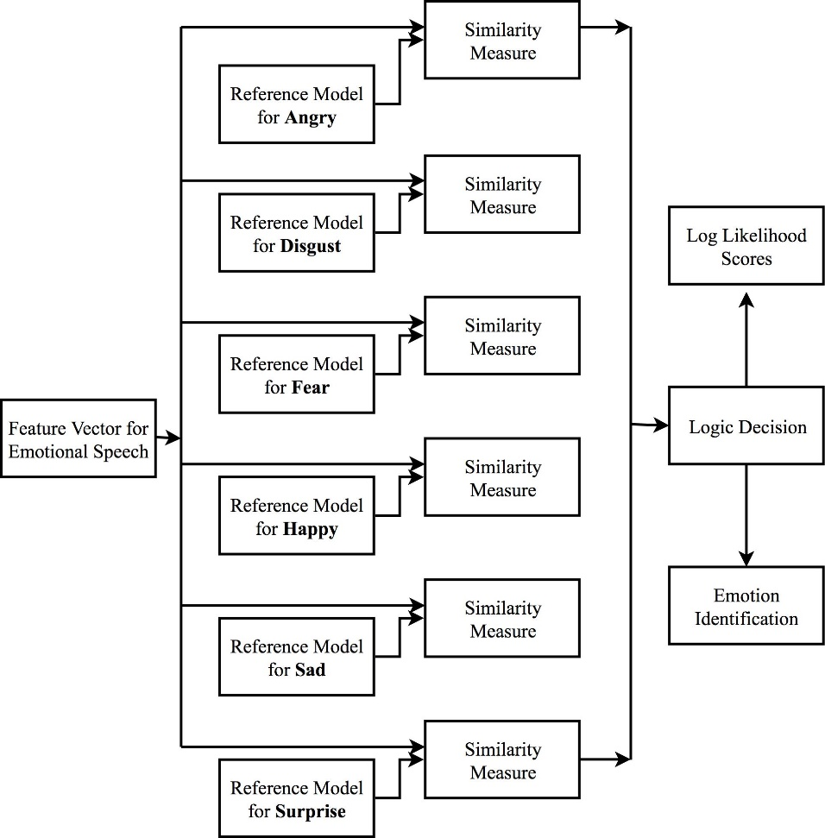
Classification: GMM
Notes:
LP VQC (Linear prediction vector quantizer coefficients)
pH VQC (Hurst parameter vector quantizer coefficients)
Radial Basis Function Neural Network (RBFNN)

Slide 12
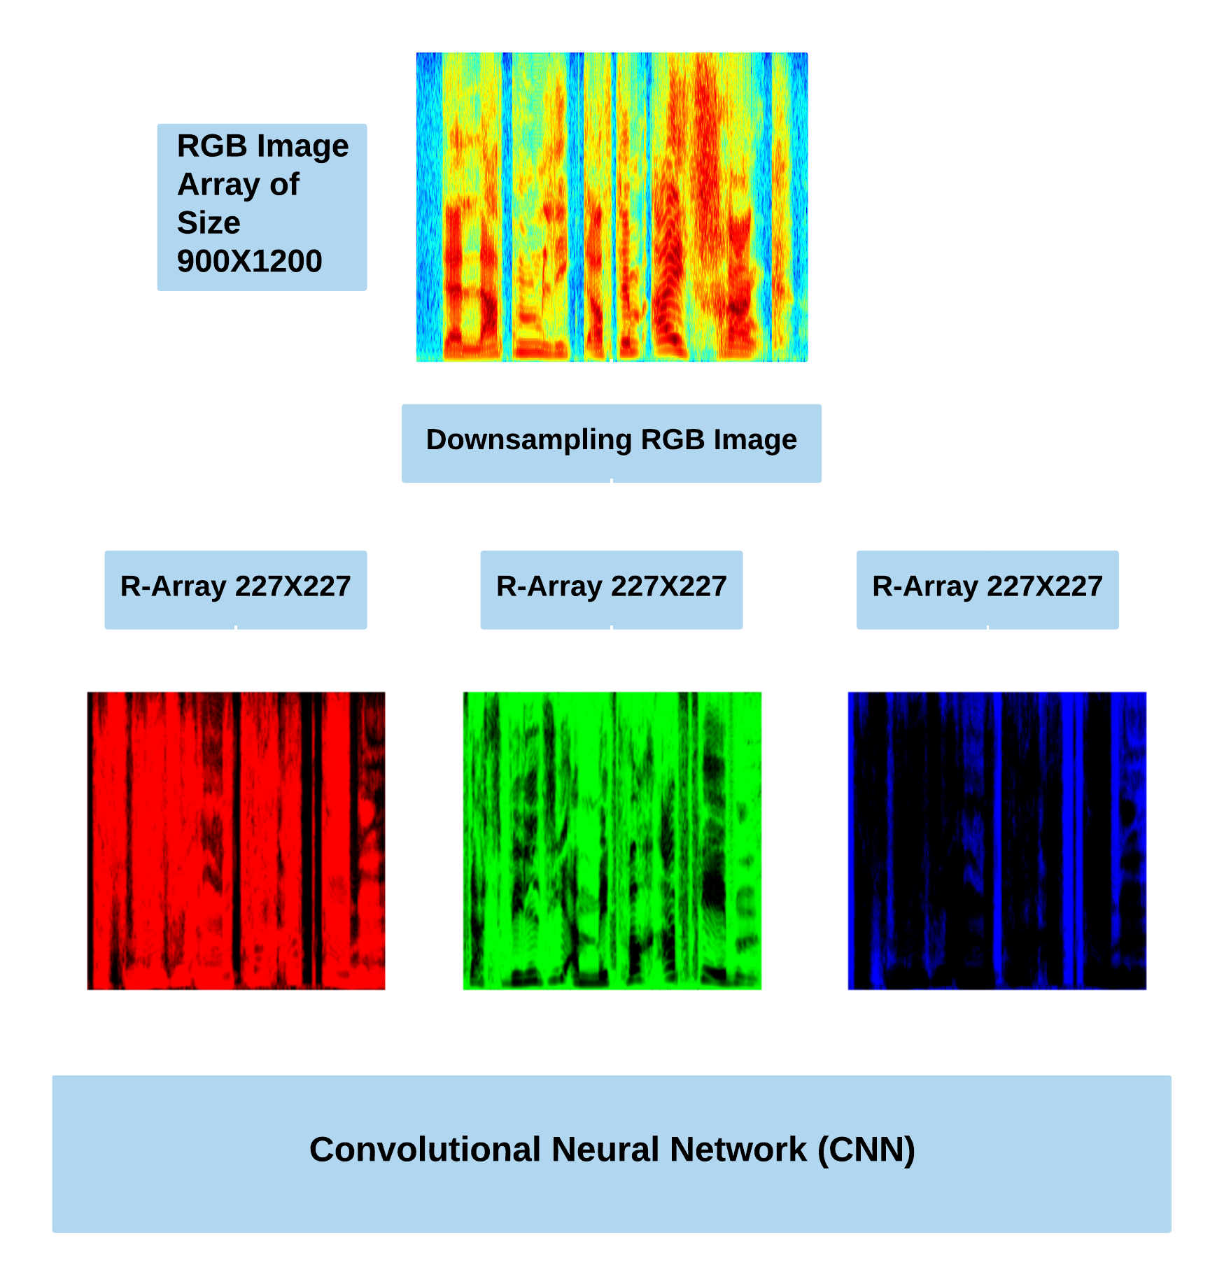
Classification: CNN
Notes:
LP VQC (Linear prediction vector quantizer coefficients)
pH VQC (Hurst parameter vector quantizer coefficients)
Radial Basis Function Neural Network (RBFNN)

Slide 13
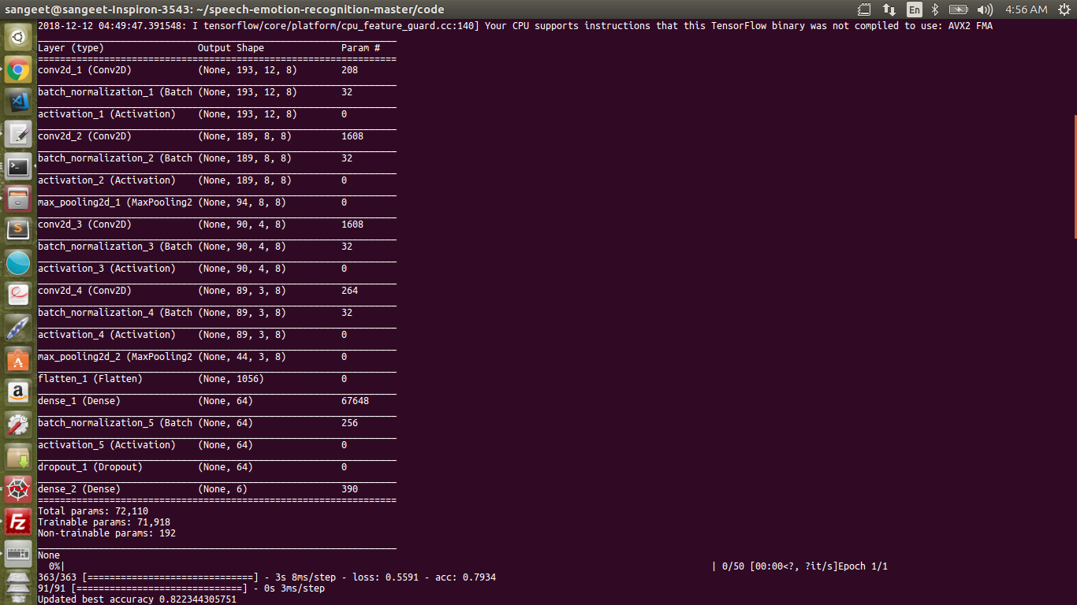
CNN Architecture
Pavol Harár, Radim Burget and Malay Kishore Dutta, “Speech Emotion Recognition with Deep Learning,” Signal Processing and Integrated Networks (SPIN), 2017 4th International Conference on Signal Processing and Integrated Networks.
Notes:
LP VQC (Linear prediction vector quantizer coefficients)
pH VQC (Hurst parameter vector quantizer coefficients)
Radial Basis Function Neural Network (RBFNN)

Slide 14
Results and Outcomes
Emotions Taken | Angry, Happy, Neutral, Sad,
Total samples in each emotion | 339 (127+71+79+62)
Training Data | 80% from each Emotion 271 Samples in total
Testing Data | 20% form each Emotion 67 samples in total

Slide 15
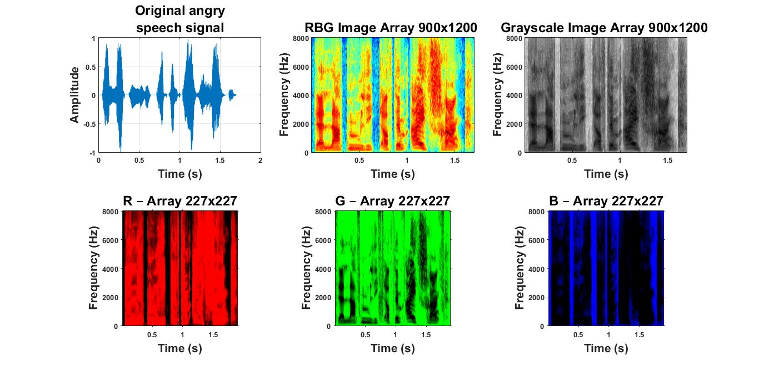
Results, Cont’d…

Slide 16
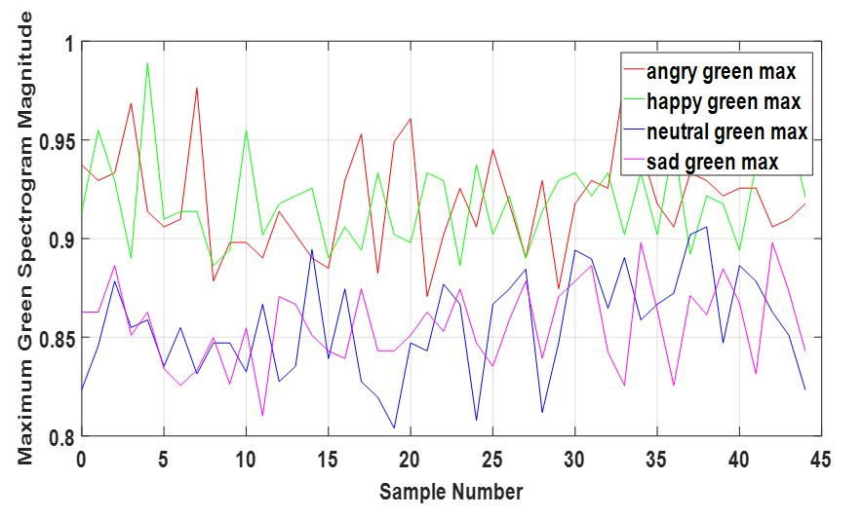
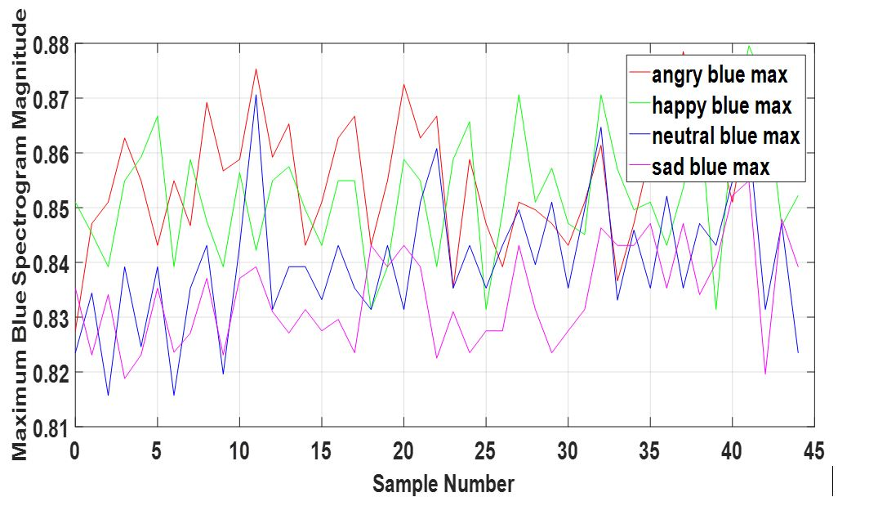
Results, Cont’d… : Characterization
Maximum Green Spectrogram Magnitude across all Emotions
Maximum Blue Spectrogram Magnitude across all Emotions
Notes:
Green- The maximum spectrogram magnitude values of happy and angry are higher than either the sad or neutral states. The emotional states such as anger or happiness have a higher arousal level with higher energy components.
Blue- The angry state has shown a higher maximum spectrogram magnitude followed by the happy state as earlier.

Slide 17
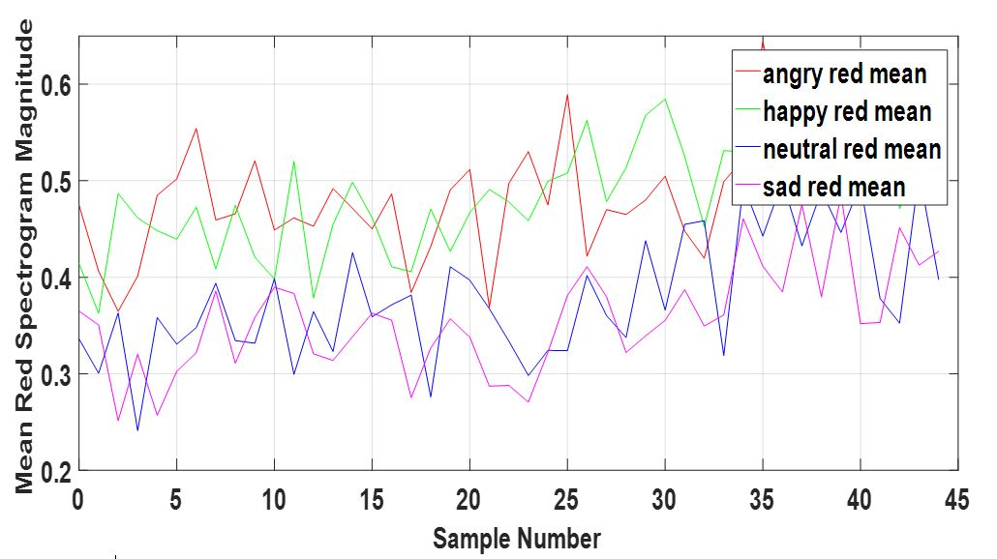
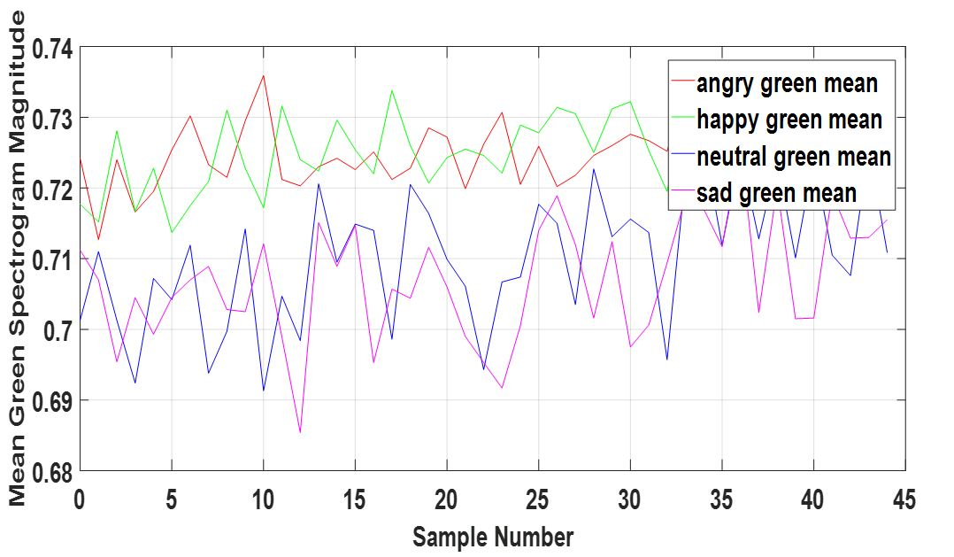
Results, Cont’d… : Characterization
Mean Red Spectrogram Magnitude across the Emotions
Mean Green Spectrogram Magnitude across the Emotions

Slide 18
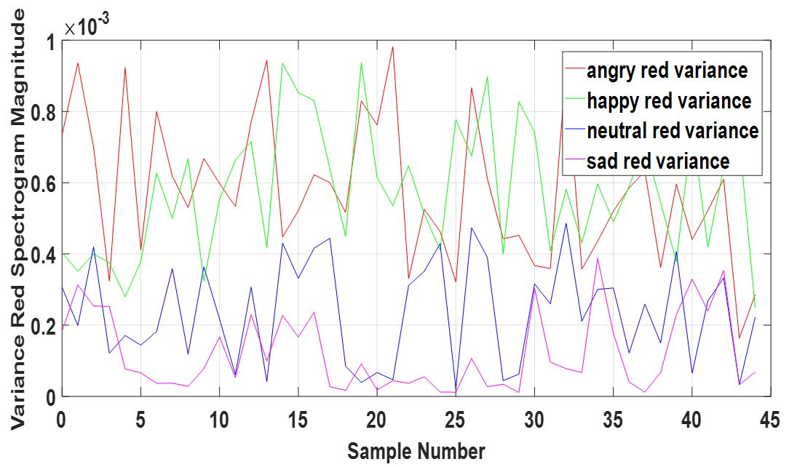
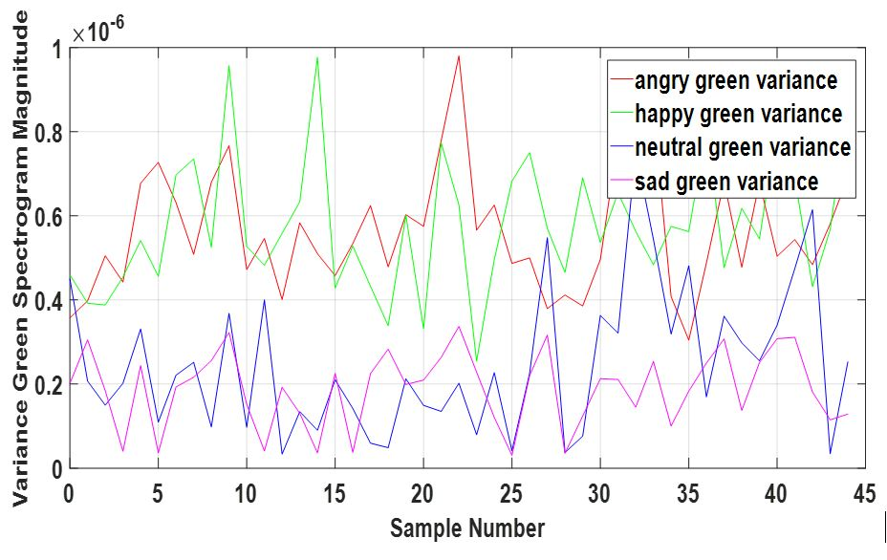
Results, Cont’d… : Characterization
Variance Red Spectrogram Magnitude across the Emotions
Variance Green Spectrogram Magnitude across the Emotions

Slide 19
Results, Cont’d… : Classification
Feature dimension used for testing | Spectrogram
Total testing features | 16186
Features classified as Angry | 4570
Features classified as Happy | 2996
Features classified as Neutral | 4846
Features classified as Sad | 3774
Average accuracy % | 86.8113%

Slide 20
Results, Cont’d… : Classification
Feature Extraction Technique | GMM | CNN
MFCC | 76.08% [1] | 85.33% [4]
RGB | 86.811% | 88.46%
MFCC+RGB | 85.13% | 91.54%

Slide 21
Conclusion
This work uses the RGB components of spectrogram image for the characterization of different emotional speech signals.
The classification result shows the RGB spectrogram magnitudes are both reliable and discriminative in classifying speech emotions in CNN platform
Statistical parameter –Maximum green spectrogram suggests that emotional states such as anger or happiness have a higher arousal level with higher energy components.
RGB feature when fed into GMM gave classification accuracy of 86.81% where as when fed into CNN gave 88.46% as average classification accuracy, thus making CNN more reliable over GMM.
Combination of MFCC and RGB performed well in CNN.

Slide 22
Future Work
These spectrograms were plotted on linear scale. Other scales like log scale, mel scale, bak scale and erb scale can also be used and better classification accuracy may be observed.
A further combination of these RGB components with other prosodic or spectral features may provide new insight in the characterization of emotional contents in the voice communication.
The spectrograms were calculated using FFT. Fractional-FFT may also be used to implement the same.
The proposed architecture of the CNN is just one of the architecture. More layers like average pooling and max pooling can be added to improve the classification accuracy but that would demand systems with high end configurations.

Slide 23
References
A. Harimi, A. Shahzadi, A. Ahmadyfard, and K.Yaghmaie, “Classification of emotional speech using spectral pattern features,” J. of AI and Data Mining, vol. 2, no.1, pp.53-61, June 2014.
W. Lim, D. Jang, and T. Lee, “Speech emotion recognition using convolutional and recurrent neural networks,” IEEE Signal and information processing association annual summit and conference (APSIPA), Asia-Pacific, Jeju, December 13, pp. 1-4, .2016.
M. Bashirpour, and M. Geravanchizadeh, “Robust emotional speech recognition based on binaural model and emotional auditory mask in noisy environments,” EURASIP J. on Audio, Speech, and Music Processing, Springer, https://doi.org/10.1186/s13636-018-0133-9, pp. 2-13, 2018.
H. M. Fayek, M. Lech, and L. Cavedon “Evaluating deep learning architectures for Speech Emotion Recognition,” Neural Networks, vol. 92, August 1, pp. 60-68, 2017
L. He, M. Lech, N. C. Maddage and N. Allen, “Stress Detection Using Speech Spectrograms and Sigma-pi Neuron Units,” 2009 Fifth International Conference on Natural Computation, Tianjin, 2009, pp. 260-264.
Z. Huang, M. Dong, Q. Mao, and Y. Zhan, “Speech emotion recognition using CNN,” Proceedings of the 22nd ACM international conference on Multimedia, Nov 3, pp. 801-804, 2014

Slide 24
Thank You

Slide 25
Demo Video

Slide 26
Demo Video will be added later on.
Notes:
LP VQC (Linear prediction vector quantizer coefficients)
pH VQC (Hurst parameter vector quantizer coefficients)
Radial Basis Function Neural Network (RBFNN)

